Slide 1


Slide 2
The Accounting Cycle: The Mechanics of Accounting

Slide 3
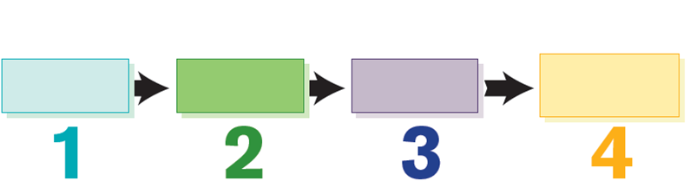
The Accounting Cycle
How Do Transactions Affect the Accounting Equation?
LO1
The procedure for analyzing, recording, summarizing, and reporting the transactions of a business.
Analyze transactions.
Record the effects of
transactions.
Exchange Transactions
(Business enter into exchange transactions
signaling the beginning of the accounting cycle)
1
2
Step
Step
Summarize the effects of
transactions.
1 Posting journal entries.
2 Preparing a trial balance.
Prepare reports.
1 Adjusting entries.
2 Preparing financial statements.
3 Closing the books.
3
4
Exhibit 3.1
Step
Step

Slide 4
Which Events Are to Be Reflected in The Accounting Records?
LO1
Determining the Amount of a Transaction
Events that cannot be reliably measured in monetary terms will not be reflected in the financial statements.
Information relating to the competitive environment, product development, and marketing and sales efforts is included in a company’s annual report to stockholders, but not as part of the accounting information.

Slide 5

Which Events Are to Be Reflected in The Accounting Records?
LO1
Competitive attempts to gain market share, like developing a Big Mac clones, could have a serious impact on a company’s profitability, but are not reported in the financial statements.

Slide 6
Which Events Are to Be Reflected in The Accounting Records?
LO1
Determining If an Arm’s-length Transaction Has Occurred
Accounting is concerned primarily with reflecting the effects of transactions between two independent entities.
e.g., China Airlines signing a contract with Boeing to purchase airplanes in the future.

Slide 7
The Accounting Equation
LO1
The accounting equation:
The equation must always remain in balance.
Assets
=
Liabilities
+
Equity
Resources owned or controlled by the firm
Creditors’ claim against
the firm’s resources
Requires repayment
Owners’ claim against the firm’s resources
Requires no repayment but represents ownership interest in the firm

Slide 8
The Accounting Equation
LO1
Business Activity (Transaction) #1:
Investment of €50,000 by owners.
Assets
=
Liabilities
+
Equity
Cash
Capital Stock
TRANSACTION # | ASSETS | = | LIABILITIES | + | EQUITY
Beginning Balance | € 0 | = | € 0 | + | € 0
1. | +50,000 |  |  |  | +50,000
Subtotal | €50,000 | = | € 0 | + | €50,000

Slide 9
The Accounting Equation
LO1
Business Activity (Transaction) #2:
Borrowed €25,000 from bank. A note is signed to the bank.
Assets
=
Liabilities
+
Equity
Cash
Notes Payable
TRANSACTION # | ASSETS | = | LIABILITIES | + | EQUITY
Beginning Balance | € 0 | = | € 0 | + | € 0
1. | +50,000 |  |  |  | +50,000
Subtotal | €50,000 | = | € 0 | + | €50,000
2. | +25,000 |  | +25,000
Subtotal | €75,000 | = | €25,000 | + | €50,000

Slide 10
The Accounting Equation
LO1
Business Activity (Transaction) #3:
Purchased €14,000 worth of supplies on credit (will pay later).
Assets
=
Liabilities
+
Equity
Supplies
Accounts Payable
TRANSACTION # | ASSETS | = | LIABILITIES | + | EQUITY
Subtotal | €75,000 | = | €25,000 | + | €50,000
3. | +14,000 |  | +14,000
Subtotal | €89,000 | = | €39,000 | + | €50,000

Slide 11
The Accounting Equation
LO1
Business Activity (Transaction) #4:
Purchased equipment costing €15,000 for cash.
Assets
=
Liabilities
+
Equity
Equipment
Cash
TRANSACTION # | ASSETS | = | LIABILITIES | + | EQUITY
Subtotal | €75,000 | = | €25,000 | + | €50,000
3. | +14,000 |  | +14,000
Subtotal | €89,000 | = | €39,000 | + | €50,000
4. | +15,000
 | -15,000
Total | €89,000 | = | €39,000 | + | €50,000

Slide 12
Using Accounts to Categorize Transactions
LO1
Account
An accounting record in which the results of transactions are accumulated.
Shows increases, decreases, and a balance.
You can think of an individual account as a summary of every transaction affecting a certain item.

Slide 13
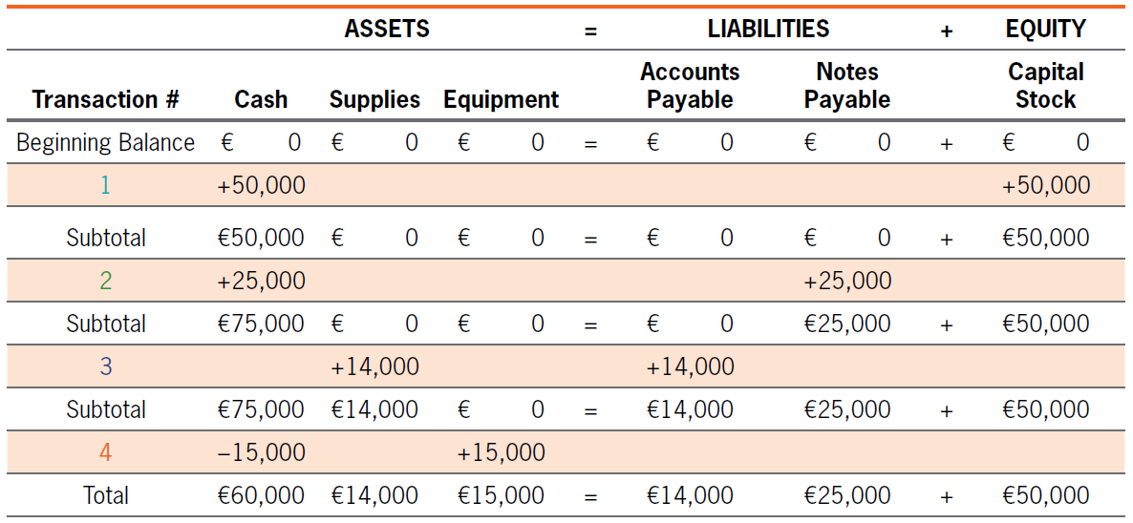
Using Accounts to Categorize Transactions
LO1
€89,000
€39,000
€50,000

Slide 14

Using Accounts to Categorize Transactions
LO1
T-Account
An abbreviated representation of an actual account.
Used as a teaching and learning tool.
Debit: the left side of a T-account.
Credit: the right side of a T-account.
Debit means left, credit means right—nothing more, nothing less.
Cash
Debit (Dr)
Credit (Cr)

Slide 15

Using Accounts to Categorize Transactions
LO1
T-Account
By convention, for asset accounts, debits refer to increases and credits to decreases. Asset accounts will usually have debit balances.
Liability and equity accounts are decreased by debits and increased by credits. As a result, they will typically have credit balances.
Assets = Liabilities + Equity
Dr
(+)
Cr
(–)
Dr
(–)
Cr
(+)
Dr
(–)
Cr
(+)

Slide 16
Using Accounts to Categorize Transactions
LO1
Three basic facts regarding double-entry accounting:
Debits are always entered on the left side of an account and credits on the right side.
For every transaction, there must be at least one debit and one credit.
Debits must always equal credits for each transaction.

Slide 17
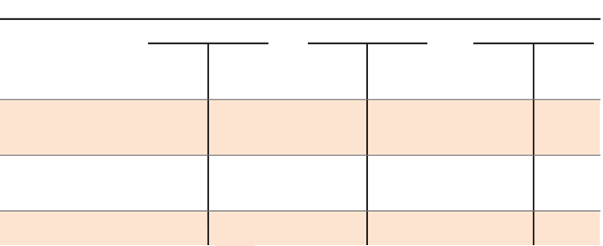
Using Accounts to Categorize Transactions
LO1
Self-Checking of Accounting Information
If debits do not equal credits, an error has been made in analyzing and recording the entity’s activities.
Business Activity (Transaction)
Effect in Terms of the Accounting Equation
Assets = Liabilities + Equity
Capital
Stock
CR(+)
Cash
DR (+)
1. Investment by owners
2. Borrowed money
from bank
Notes
Payable
CR(+)
Cash
DR (+)
3. Purchased
supplies on credit
Accounts
Payable
CR(+)
Supplies
DR(+)
4. Purchased equipment
for cash
Equipment
DR(+)
Cash
CR (-)

Slide 18
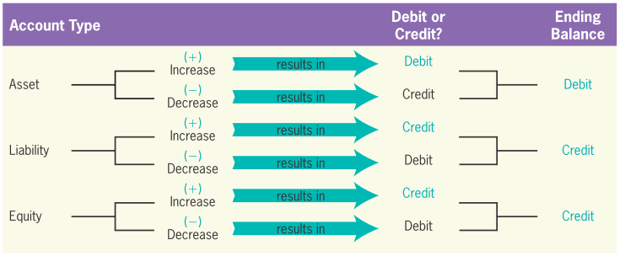
Using Accounts to Categorize Transactions
LO1
Debit-Credit Rule

Slide 19
Expanding the Accounting Equation
LO1
Temporary Accounts that Affect Equity
Temporary accounts.
They are closed into the Retained Earnings account at the end of the accounting cycle.
Equity
Expenses
increase
decrease
Revenues
Dividends
Increased by credits
Increased by debits

Slide 20
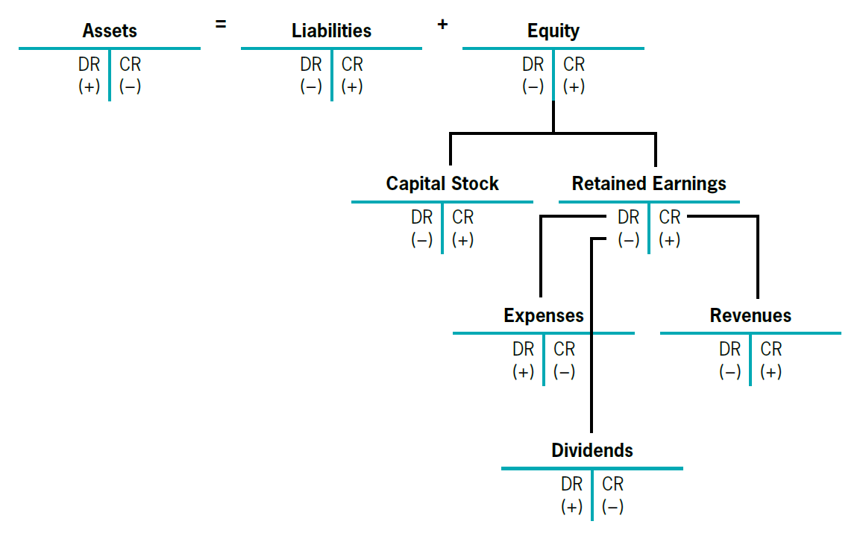
Expanded Accounting Equation
LO1
Exhibit 3.2

Slide 21
Quiz Yourself
LO1
For each of the following three transactions, determine
(a) the specific accounts involved;
(b) whether the accounts increased or decreased;
(c) whether the accounts are assets, liabilities, or equity accounts; and
(d) whether the accounts are debited or credited.

Slide 22
Quiz Yourself
LO1
Solution:
Borrowed money from a bank
(a) The accounts involved are Cash and Loans Payable.
(b) Both Cash and Loans Payable increased.
(c) Cash is an asset, and Loans Payable is a liability.
(d) Assets increase with a debit. Cash is an asset; therefore, Cash is debited.
Liabilities increase with a credit. Loans Payable is a liability; therefore, Loans Payable is credited.

Slide 23
Quiz Yourself
LO1
Purchased a car on credit
(a) The accounts involved are Car and Accounts Payable.
(b) Both Car and Accounts Payable increased.
(c) Car is an asset, and Accounts Payable is a liability.
(d) Assets increase with a debit. Car is an asset; therefore, Car is debited.
Liabilities increase with a credit. Accounts Payable is a liability; therefore, Accounts Payable is credited.

Slide 24
Quiz Yourself
LO1
Purchased equipment paying cash
(a) The accounts involved are Equipment and Cash.
(b) Equipment increased, and Cash decreased.
(c) Both Equipment and Cash are assets.
(d) Assets increase with a debit. Equipment is an asset; therefore, Equipment is debited.
Assets decrease with a credit. Cash is an asset; therefore, Cash is credited.

Slide 25
Journals and Journal Entries
How Do We Record the Effects of Transactions?
LO2
Journal
Provide a chronological record of all transactions of a business.
General journal.
Larger companies may use special journals and a general journal.

Slide 26
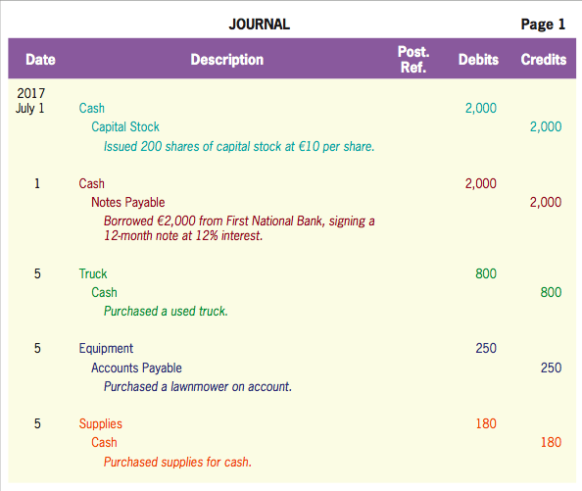
Journals and Journal Entries
LO2
General Journal
Exhibit 3.3

Slide 27
Journals and Journal Entries
LO2
Journal Entry
General Journal Entry Format
1
Date
2
Debit Entry …………………...………… XX
3
Credit Entry ………………….……….. XX
4
Explanation.
Dollar signs usually are omitted

Slide 28
Journal Entry Example
LO2
Suppose you want to have an outdoor job and decide to start your own landscaping business. This business will involve mowing lawns, pulling weeds, trimming and planting shrubs, and so forth.
These transactions fit into the following four general categories:
Acquiring cash
Acquiring assets other than cash
Providing services
Collecting cash and paying obligations

Slide 29
Journal Entry Example
LO2
Acquiring Cash
Example 1: Acquiring Cash from Owners
Your parents offer to match any funds that you are going to put into your business. You have €1,000 in savings, and coupled with your parents’ matching funds, you decide to issue 200 shares of stock on July 1, 2017.
Transaction effect
The asset-cash account increases by €2,000 and the equity-capital stock account increases by €2,000.
Journal entry
July 1
Cash
2,000
Capital Stock
2,000
Issue 200 shares of capital stock at €10 per share.

Slide 30
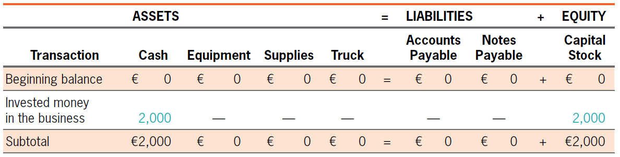
Journal Entry Example
LO2
Example 1: Acquiring Cash from Owners

Slide 31
Journal Entry Example
LO2
Example 2: Acquiring Cash by Borrowings
Suppose that on top of the money from yourself and your parents, you went to a bank on July 1, 2017 and convinced the loan officer to lend you some additional money.
Transaction effect
The asset-cash account increases by €2,000 and the liability-notes payable account increases by €2,000.
Journal entry
July 1
Cash
2,000
Notes Payable
2,000
Borrowed € 2,000 from First National Bank, signing a 12-month note at 12% interest.

Slide 32
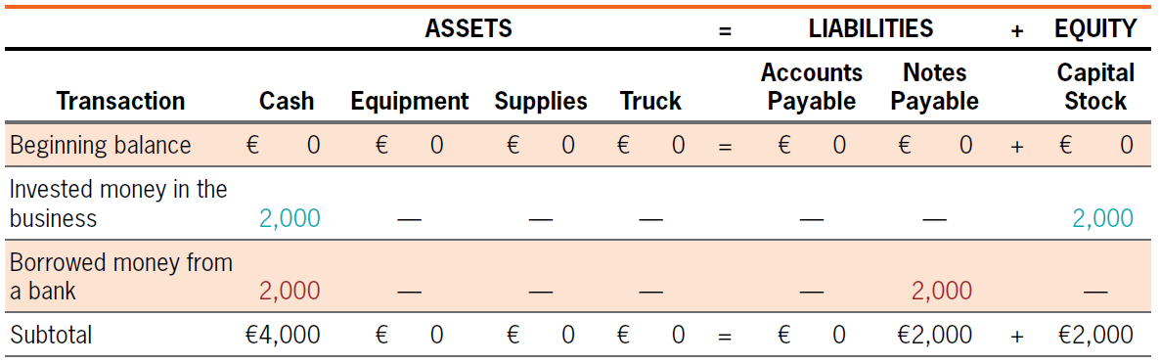
Journal Entry Example
LO2
Example 2: Acquiring Cash by Borrowings
A “note” is a contract specifying an amount that one party will repay to another, usually with interest along the way. This particular account could also be called “Loan Payable.”

Slide 33
Journal Entry Example
LO2
Acquiring Assets Other than Cash
Such assets include supplies (like fertilizer), and equipment (like a lawnmower and a truck for hauling).
These assets may be purchased with cash or on credit. Credit purchases require payment after a period of time.

Slide 34
Journal Entry Example
LO2
Example 3: Acquiring Noncash Assets
The first thing you need is a lawnmower and some form of transportation. On July 5, 2017. You find an old 2001 pickup truck for sale for €800, and you buy it paying cash.
Transaction effect
The asset-truck account increases by €800 and the asset-cash account decreases by €800.
Journal entry
July 5
Truck
800
Cash
800
Purchased a used truck.

Slide 35
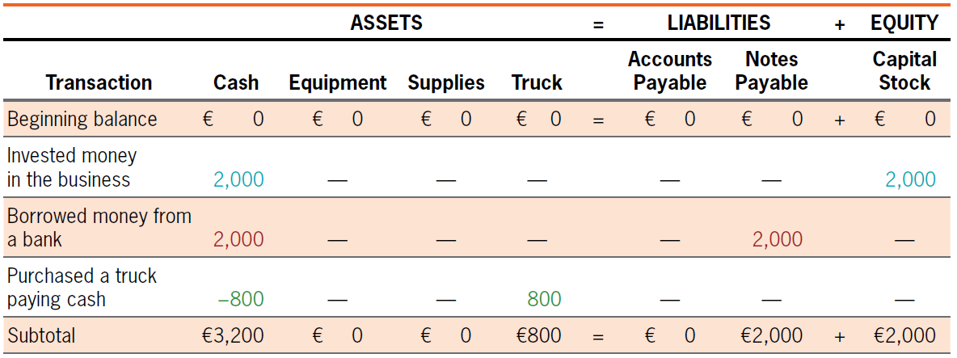
Journal Entry Example
LO2
Example 3: Acquiring Noncash Assets

Slide 36
Journal Entry Example
LO2
Example 4: Acquiring Noncash Assets
Next, you drive to the local lawn-and-garden store and purchase a lawnmower and gas can for €250 on July 5, 2017. Instead of paying for the mower with cash, you open a charge account, which will allow you to pay for the mower in 30 days with no interest charge.
Transaction effect
The asset-equipment account increases by €250 and the liability-accounts payable account increases by €250.
Journal entry
July 5
Equipment
250
Accounts Payable
250
Purchased a lawnmower and gas can on account.

Slide 37
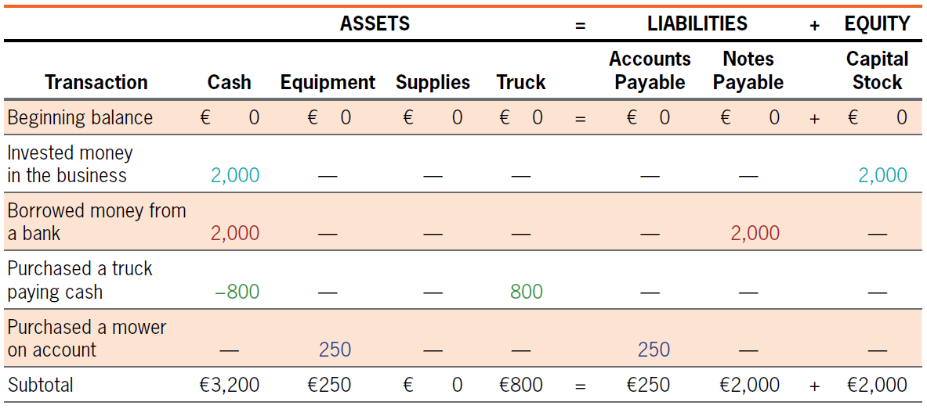
Journal Entry Example
LO2
Example 4: Acquiring Noncash Assets

Slide 38
Journal Entry Example
LO2
Example 5: Acquiring Noncash Assets
Back you go to the lawn-and-garden store on July 5, 2017 to purchase fertilizer, gloves, a rake, a shovel, and other assorted supplies. The total cost is €180, which you pay in cash.
Transaction effect
The asset-supplies account increases by €180 and the asset-cash account decreases by €180.
Journal entry
July 5
Supplies
180
Cash
180
Purchased supplies for cash.

Slide 39
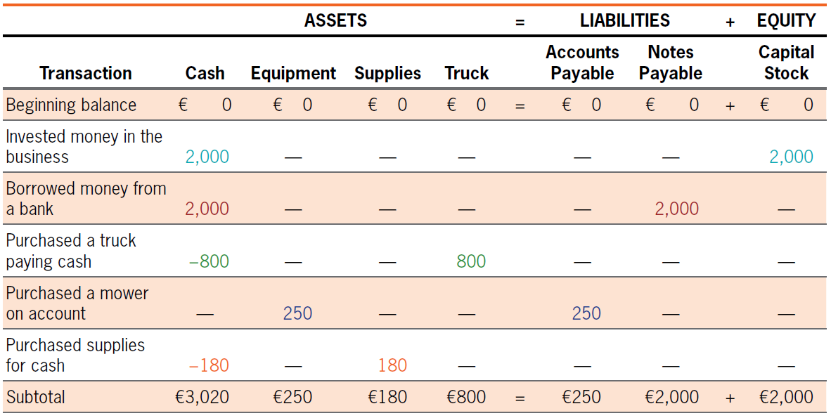
Journal Entry Example
LO2
Example 5: Acquiring Noncash Assets
An increase in one asset (supplies) results in a decrease in another asset (cash).

Slide 40
Journal Entry Example
LO2
Providing Services
Sometimes services are rendered for cash; at other times they are rendered on credit, and a receivable is established for collection at a later date.
Revenues indicate the source not only of cash but of other assets as well, all of which are received in exchange for the services provided.
Similarly, expenses may be “charged” with a cash payment to be made at a later date.

Slide 41
Journal Entry Example
LO2
Example 6: Providing Services
On July 9, 2017, you perform a lawn care service for €350. A portion of your revenues is received immediately in cash (€270), while the balance becomes receivables.
The asset-cash account increases by €270, the asset-accounts receivable account increases by €80
and the revenue account increases by €350; in turn, equity increases by €350.
Transaction effect
Journal entry
July 9
Cash
270
Accounts Receivable
80
Lawn Care Revenue
350
To record revenue for lawn care services.

Slide 42
Journal Entry Example
LO2
Example 6: Providing Services
Compound journal entry: The type of entry which more than two accounts can be involved in recording a transaction of entry.
“Revenue” is not an asset.
Revenue
Assets
The label given to the source of assets
Capital Stock
Liability

Slide 43
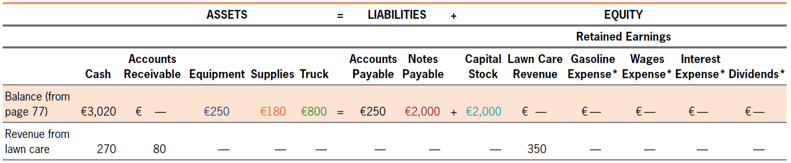
Journal Entry Example
LO2
Example 6: Providing Services

Slide 44
Journal Entry Example
LO2
Example 7: Incurring Expenses
Expenses include gas (€50) for the lawnmower and the truck on July 18, 2017 and the wages (€60) you agreed to pay your little brother for working for you on July 23, 2017.
Transaction effect
The gasoline expenses (wages expenses) account increases by €50 (€60); in turn, equity decreases by €50 (€60); and the asset-cash account decreases by €50 (€60).
July 18
Gasoline Expenses
50
Cash
50
Journal entry
Pay cash for gas for the truck and the mower.
July 23
Wages Expenses
60
Cash
60
Pay wages expense.

Slide 45
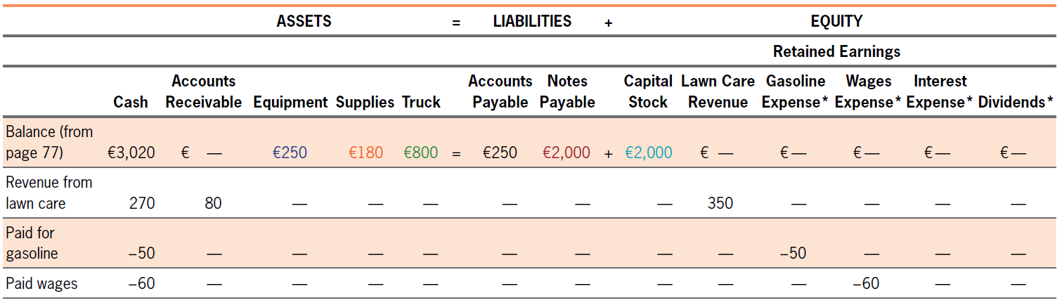
Journal Entry Example
LO2
Example 7: Incurring Expenses
The label “expenses” is used to explain how assets have been used.
“Expenses” is the label we give to the amount of assets consumed in doing business.

Slide 46
Journal Entry Example
LO2
Collecting Cash and Paying Obligations
Example 8: Collecting Accounts Receivable
The receivables are collected on July 30, 2017.
Transaction effect
The asset-cash account increases by €80 and the asset-accounts receivable account decreases by €80.
July 30
Cash
80
Journal entry
Accounts Receivable
80
Collected €80 of receivables.

Slide 47
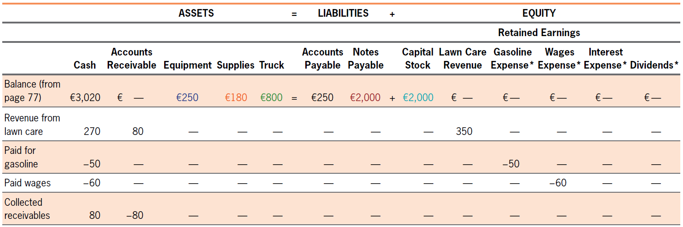
Journal Entry Example
LO2
Example 8: Collecting Accounts Receivable
The collection of receivables merely involves exchanging one asset for another. No revenue is involved here.

Slide 48
Journal Entry Example
LO2
Example 9: Paying Obligations
On July 31, 2017, you pay for the obligation with cash of purchasing lawnmower and gas on account.
Transaction effect
The asset-cash account decreases by €250 and the liability-accounts payable account decreases by €250.
July 31
Accounts Payable
250
Journal entry
Cash
250
Paid €250 for the lawnmower and gas can previously purchased.

Slide 49
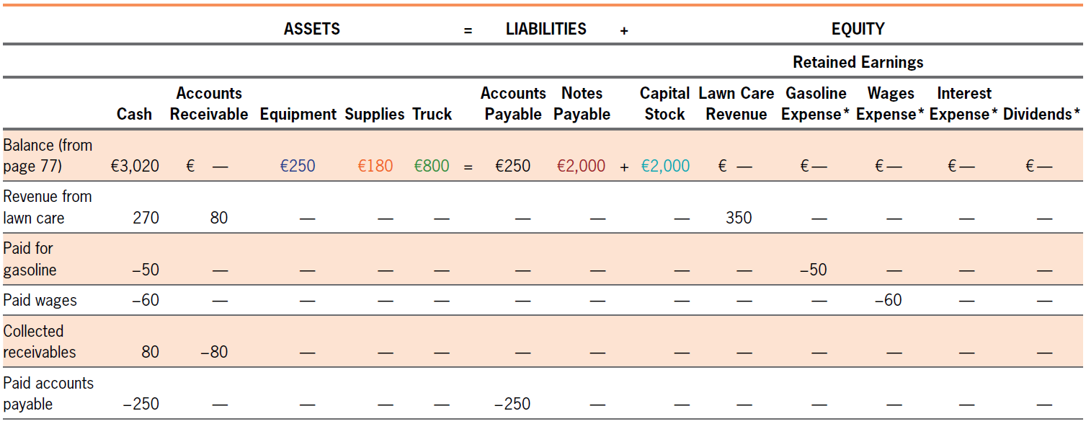
Journal Entry Example
LO2
Example 9: Paying Obligations

Slide 50
Journal Entry Example
LO2
Example 10: Paying Obligations and Interest
In example 2, you borrowed €2,000 to be paid over 12 months. Suppose you are required to make monthly loan payments of €178 with a portion of each payment being attributed to interest and a portion to reducing the liability on July 31, 2017.
The asset-cash account decreases by €178, the liability-notes payable account decreases by €158 and the interest expense account increases by €20 which in turn decreases equity by €20.
Transaction effect
July 31
Notes Payable
158
Journal entry
Interest Expense
20
Cash
178
Paid first monthly payment on note with interest (€2,000 × 0.12 × 1/12).

Slide 51
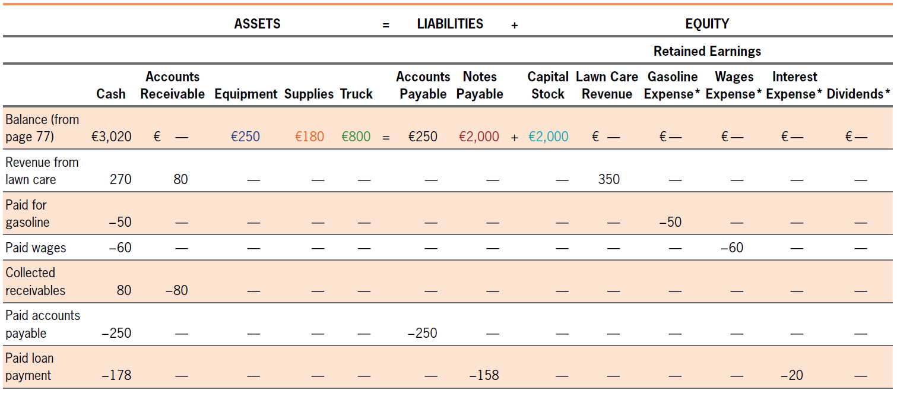
Journal Entry Example
LO2
Example 10: Paying Obligations and Interest

Slide 52
Journal Entry Example
LO2
Example 11: Payment of Dividends
Corporations that are profitable generally pay dividends to their stockholders. The following entry illustrates the payment of a cash dividend (€50) on July 31, 2017:
The asset-cash account decreases by €50 and the dividends account increases by €50 which in turn
decreases equity by €50.
Transaction effect
July 31
Dividends
50
Journal entry
Cash
50
Paid a €50 cash dividends.

Slide 53
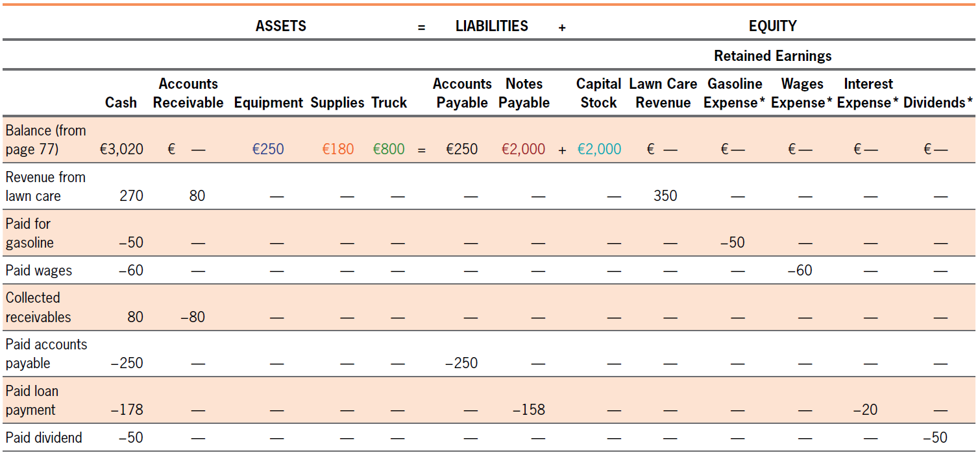
Journal Entry Example
LO2
Example 11: Payment of Dividends

Slide 54
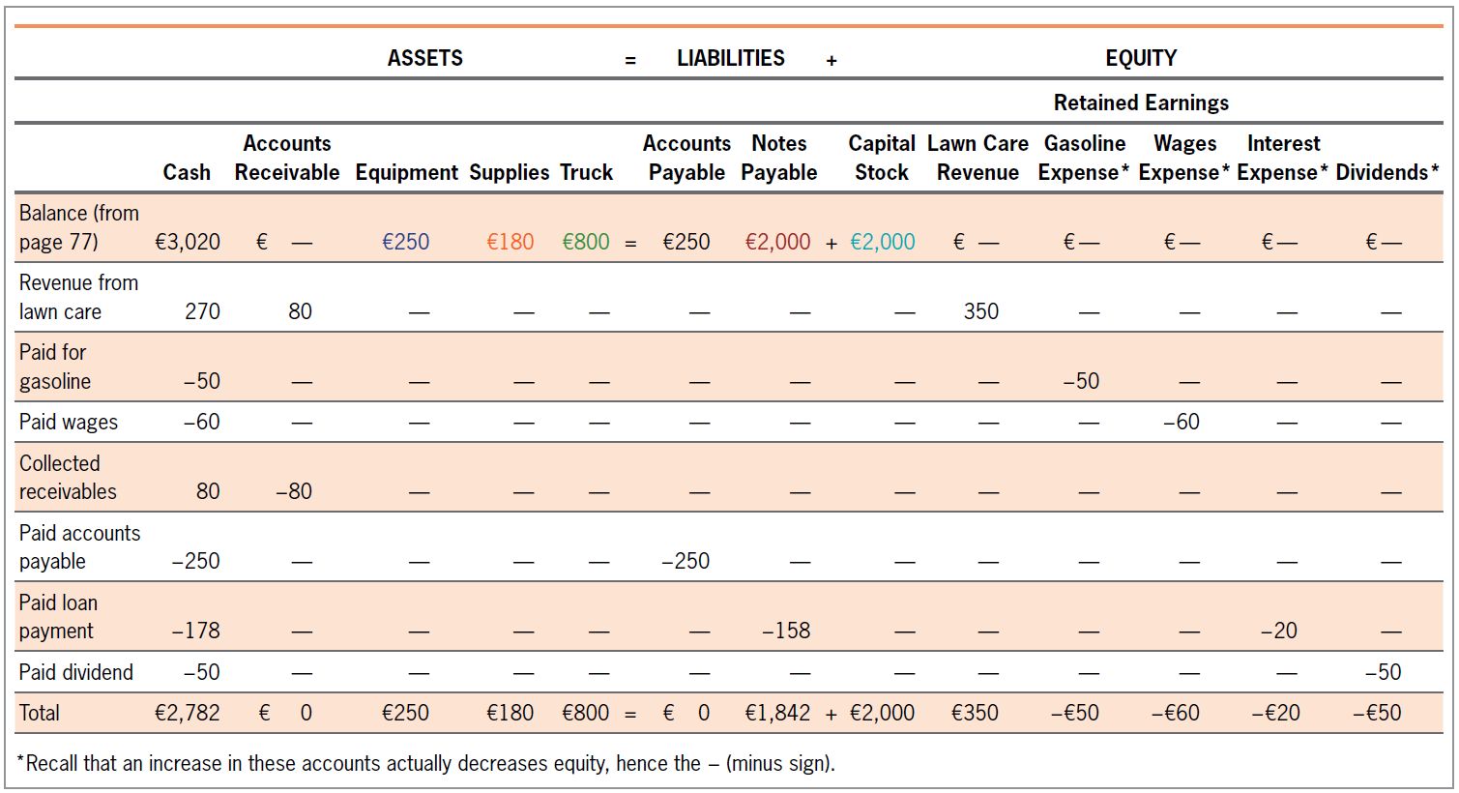
Summary of Transactions
LO2
Exhibit 3.4

Slide 55
A Note on Journal Entries
LO2
A Journal Entry Involves a Three-step Process:
Identify which accounts are involved.
For each account, determine if it is increased or decreased: are to debited or credited.
For each account, determine by how much it has changed.

Slide 56
Quiz Yourself
LO2
For each of the following transactions,
(a) identify the accounts involved,
(b) identify whether the accounts increased or decreased,
(c) state by how much the accounts increased or decreased, and
(d) provide the required journal entry to record the effects of the transaction.

Slide 57
Quiz Yourself
LO2
Purchased supplies costing €5,000 on account
(a) Supplies is an asset, Accounts Payable is a liability.
(b) Supplies increased (assets increase with debits), and Accounts Payable increased (liabilities increase with credits).
(c) Both accounts changed by €5,000.
(d) The required journal entry is
Supplies.................................... | 5,000
Accounts Payable ............. |  | 5,000

Slide 58
Quiz Yourself
LO2
Paid wages of €200
(a) Wages is an expense (expenses are equity accounts), Cash is an asset.
(b) Wages Expense increased (expense decrease equity, and equity decreases with debits), and Cash decreased (assets decrease with credits).
(c) Both accounts changed by €200.
(d) The required journal entry is
Wages Expense........................ | 200
Cash ................................. |  | 200

Slide 59
Quiz Yourself
LO2
Paid €3,600 for supplies purchased previously
(a) Cash is an asset, Accounts Payable is a liability.
(b) Cash decreased (assets decrease with credits), and Accounts Payable decreased (liabilities decrease with debits).
(c) Both accounts changed by €3,600.
(d) The required journal entry is
Accounts Payable .................... | 3,600
Cash ................................. |  | 3,600

Slide 60
Posting Journal Entries
Posting Journal Entries and Preparing a Trial Balance
LO3
Posting
The process of transferring amounts from the journal to the ledger.
It is no more than sorting all journal entry amounts by account and copying those amounts to the appropriate account.

Slide 61
Posting Journal Entries
LO3
Ledger
All accounts are maintained in an accounting record called a “ledger.”
A ledger (the main ledger is called a general ledger) is a “book of accounts.”

Slide 62
Posting to the General Ledger
LO3
Exhibit 3.5
JOURNAL |  |  |  | Page 1
Date | Description | Post. Ref. | Debits | Credits
2017 July 1 | Cash | 101 | 2,000
 | Capital Stock |  |  | 2,000
 | Issued 200 shares of capital stock at € 10 per share.
1 | Cash | 101 | 2,000
 | Notes Payable |  |  | 2,000
 | Borrowed €2,000 from First National Bank, signing a 12-month note at 12% interest.
5 | Truck |  | 800
 | Cash | 101 |  | 800
 | Purchased a used truck.
5 | Equipment |  | 250
 | Accounts Payable |  |  | 250
 | Purchased a lawnmower on account.
5 | Supplies |  | 180
 | Cash | 101 |  | 180
 | Purchased supplies for cash.
ACCOUNT: Cash |  |  | ACCOUNT NO. 101
Date | Description | Post. Ref. | Debits | Credits | Balance
2017 July 1 | Balance |  |  |  | 0
1 | Issued 200 shares of capital stock at € 10 per share. | GJ1 | 2,000 |  | 2,000
1 | Borrowed €2,000 from First National Bank, signing a 12-month note at 12% interest. | GJ1 | 2,000 |  | 4,000
5 | Purchased a used truck. | GJ1 |  | 800 | 3,200
5 | Purchased supplies for cash. | GJ1 |  | 180 | 3,020

Slide 63
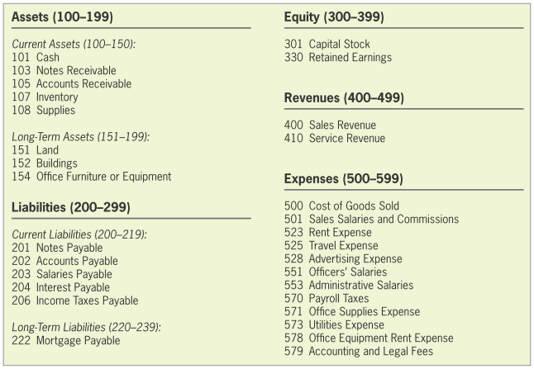
Posting to the General Ledger
LO3
Chart of Accounts
Exhibit 3.6

Slide 64
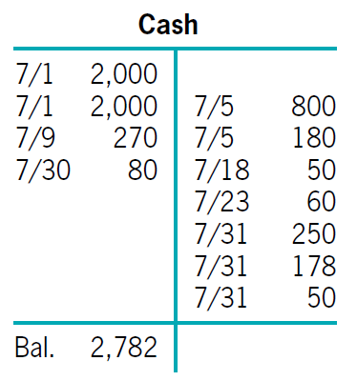
Determining Account Balances
LO3
At the end of an accounting period, the accounts in the general ledger are reviewed to determine each account’s balance.
The balance is normally on the side that increases the account.
€4,350
€1,568

Slide 65
Determining Account Balances
LO3
Trial Balance
Lists each account with its debit or credit balance.
Even if the trial balance does show total debits equal to total credits, there may be errors.

Slide 66
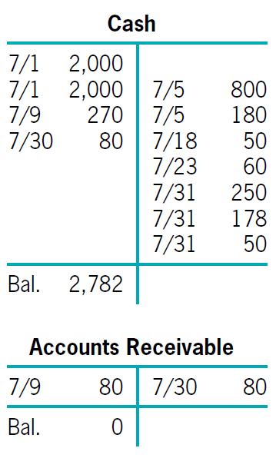
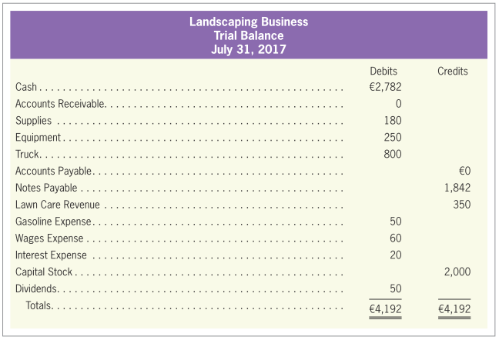
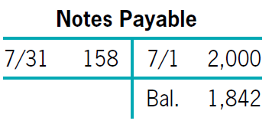
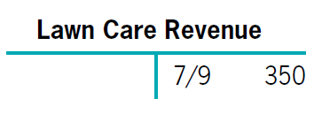
Determining Account Balances
LO3
Exhibit 3.8

Slide 67
Illustration of the First Three Steps in the Accounting Cycle
LO3
Three Steps
Step 1: Analyze these transactions and supporting documents.
Step 2: The pertinent facts are obtained and the transactions are recorded in a journal.
Step 3 (part 1): The transactions are posted to the ledger accounts. T-accounts are used to illustrate this process.
Step 3 (part 2): After the account balances have been determined, a trial balance is usually prepared.

Slide 68
Illustration of the First Three Steps in the Accounting Cycle
LO3
Suppose that Ashin and his friends established the Mayday Corporation in 2017. The following transactions occurred.
a | Initial capital contribution of €20,000, for which Ashin and friends received 1,000 shares of capital stock.
b | Borrowed €20,000 from a bank to buy some land, signing a long-term note with the bank.
c | Land was purchased for €25,000 cash.
d | During the year of 2017, Mayday Corporation provided services costing €3,200 and it was paid on credit.
e | The company paid €200 in advertising expenses and €100 in miscellaneous expenses.
f | The company collected the full amount of the account receivable in cash.

Slide 69
Illustration of the First Three Steps in the Accounting Cycle
LO3
Step 1: Analyze These Transactions and Supporting Documents.
e.g., the purchases of land are verified by invoices showing the actual items purchased, dates, amounts, and so forth. There is a €20,000 note payable to the bank. Other business documents indicate the provision of services and the expenses incurred.

Slide 70
Illustration of the First Three Steps in the Accounting Cycle
LO3
Step 2: Recording the Transactions in a Journal.
Initial capital contribution of €20,000, for which Ashin and friends received 1,000 shares of capital stock.
Borrowed €20,000 from a bank to buy some land, signing a long-term note with the bank.
Business Transaction | Journal Entries | Debits | Credits
Issued stock | Cash | 20,000
 | Capital Stock |  | 20,000
 | Issued 1,000 shares of capital stock for €20,000.
Business Transaction | Journal Entries | Debits | Credits
Borrowed money | Cash | 20,000
 | Notes Payable |  | 20,000
 | Borrowed €20,000 from a bank.

Slide 71
Illustration of the First Three Steps in the Accounting Cycle
LO3
Step 2: Recording the Transactions in a Journal.
Land was purchased for €25,000 cash.
During the year of 2017, Mayday Corporation provided services costing €3,200 and it was paid on credit.
Business Transaction | Journal Entries | Debits | Credits
Purchased land | Land | 25,000
 | Cash |  | 25,000
 | Purchased land for cash.
Business Transaction | Journal Entries | Debits | Credits
Provided services | Accounts Receivable | 3,200
 | Services Revenue |  | 3,200
 | Provided services for €3,200 on account.

Slide 72
Illustration of the First Three Steps in the Accounting Cycle
LO3
Step 2: Recording the Transactions in a Journal.
The company paid €200 in advertising expenses and €100 in miscellaneous expenses.
The company collected the full amount of the account receivable in cash.
Business Transaction | Journal Entries | Debits | Credits
Paid expenses | Advertising Expenses | 200
 | Miscellaneous Expenses | 100
 | Cash |  | 300
 | Paid advertising and miscellaneous expenses.
Business Transaction | Journal Entries | Debits | Credits
Collected cash | Cash | 3,200
 | Accounts Receivable |  | 3,200
 | Collected accounts receivable.

Slide 73
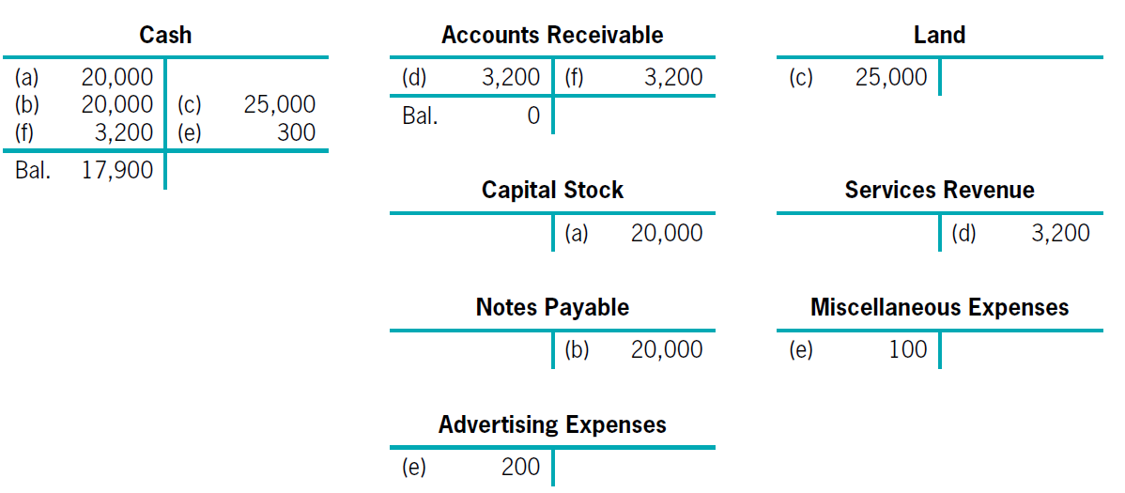
Illustration of the First Three Steps in the Accounting Cycle
LO3
Step 3-1: Posting the Journal Entries to the Ledger.
Using T-accounts.

Slide 74
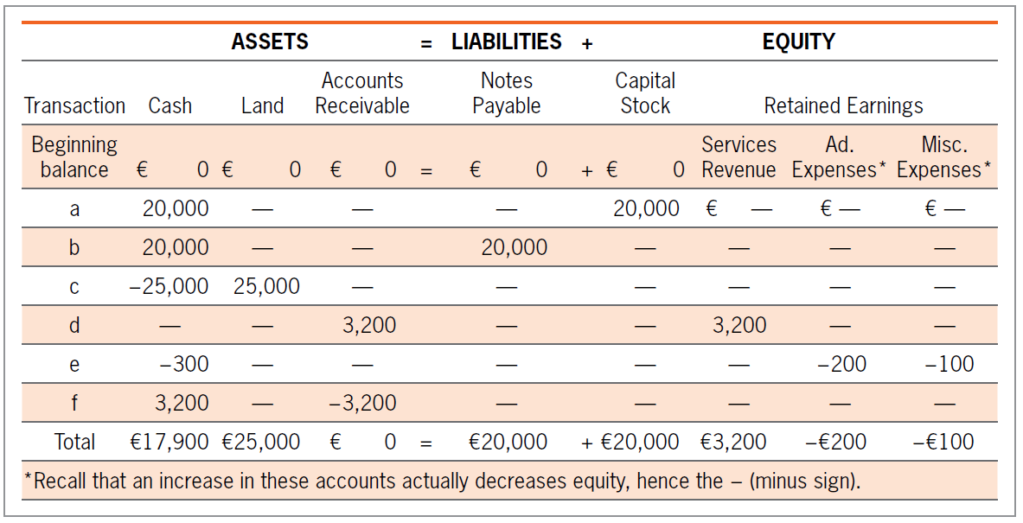
Illustration of the First Three Steps in the Accounting Cycle
LO3
Step 3-1: Posting the Journal Entries to the Ledger.
Exhibit 3.9

Slide 75
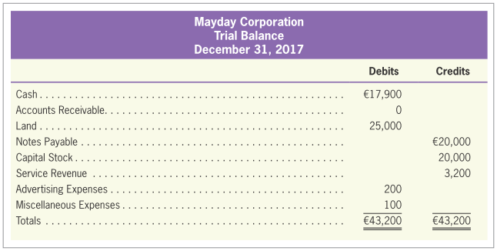
Illustration of the First Three Steps in the Accounting Cycle
LO3
Step 3-2: Preparing a Trial Balance.
Exhibit 3.10

Slide 76
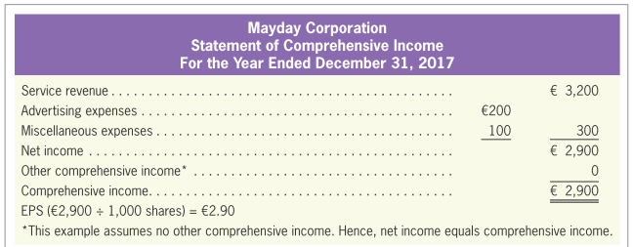
Illustration of the First Three Steps in the Accounting Cycle
LO3
Preparing Financial Statements
Exhibit 3.11

Slide 77
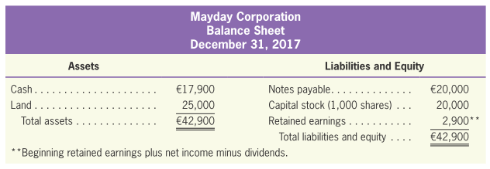
Illustration of the First Three Steps in the Accounting Cycle
LO3
Preparing Financial Statements
Notice that there is no retained earnings account in the trial balance but there is one on the balance sheet.
Because all the accounts such as Revenue and Expenses are eventually accumulated into Retained Earnings.
Exhibit 3.11

Slide 78
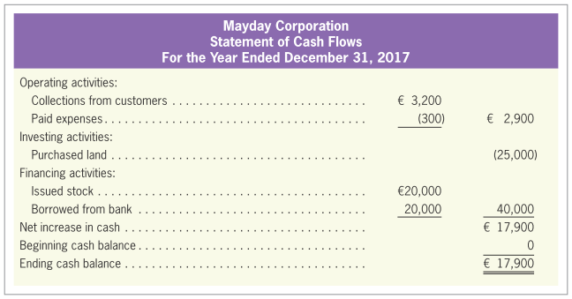
Illustration of the First Three Steps in the Accounting Cycle
LO3
Preparing Financial Statements
Exhibit 3.12

Slide 79
Illustration of the First Three Steps in the Accounting Cycle
LO3
Two Final Notes
First, the preparation of financial statements also involves the adjustment of some ledger accounts. (CH4)
Second, net income does not usually equal the ending retained earnings balance. Only in the first year of a company’s operations would this be the case.

Slide 80
Quiz Yourself
LO3
From the following four journal entries, prepare a trial balance. Assume that the beginning balance for all accounts is zero.
1 | Supplies | 2,400
 | Accounts Payable |  | 2,400
2 | Cash | 4,500
 | Services Revenue |  | 4,500
3 | Wages Expense | 1,800
 | Cash |  | 1,800
4 | Accounts Payable | 1,700
 | Cash |  | 1,700

Slide 81
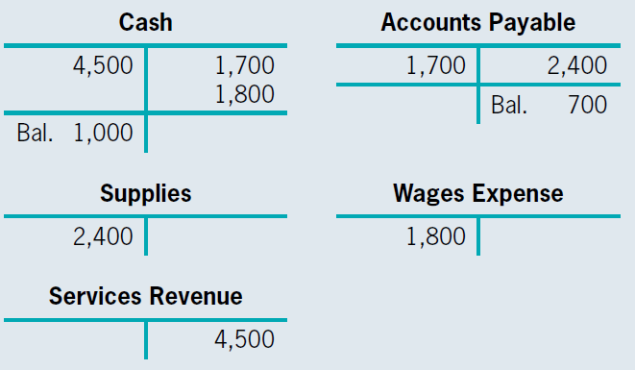
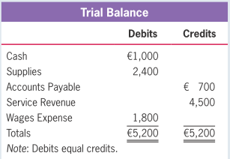
Quiz Yourself
LO3
Solution:

Slide 82
How Have Computers Changed the Accounting Cycle?
Where Do Computers Fit in All This?
LO4
The time spent posting journal entries and summarizing accounts into a trial balance has been greatly reduced as a result of computers.
Computers can’t think—that is your job!
What accounts are involved?
Did those accounts increase or decrease?
By how much did each account change?

